Slide 1
Prolog
Programming for Artificial Intelligence

Slide 2
GNU Prolog
This Prolog compiler complies with the ISO standard for Prolog (with useful extensions like global variables, ability to interface with the operating system, etc) and produces a native binary that can be run standalone. It is smart enough to avoid linking unused built-in predicates. It also has an interactive interpreter and a Prolog debugger as well as a low-level WAM debugger. You can interface with C code (both ways). Platforms supported include Linux (i86), SunOS (sparc) and Solaris (sparc).
  http://www.thefreecountry.com/compilers/prolog.shtml (Free Prolog Compilers and Interpreters )
  http://www.gprolog.org/ (The GNU Prolog web site)
  http://www.thefreecountry.com/documentation/onlineprolog.shtml (Online Prolog Tutorials)

Slide 3
Some Examples
L= [1,2,3,4], member(X, L).
L= [a, b, c], length(L, X).
X is 3 + 4.
Load a Prolog file
  consult('C:/Users/violet/Documents/EDU/Prolog/Prologcode/fig1_8.txt').

Slide 4
Tutorial
A Short Tutorial on Prolog
  As its name indicates, this is a short tutorial on Prolog programming.
  You can learn it by yourself.

Slide 5
Part 1 The Prolog Language
Chapter 1
Introduction to Prolog

Slide 6
1.1 Defining relations by facts
Given a whole family tree
The tree defined by the Prolog program:
parent( pam, bob). % Pam is a parent of Bob
parent( tom, bob).
parent( tom, liz).
parent( bob, ann).
parent( bob, pat).
parent( pat, jim).
pam
tom
bob
liz
ann
pat
jim

Slide 7
1.1 Defining relations by facts
Questions:
  Is Bob a parent of Pat?
    ?- parent( bob, pat).
    ?- parent( liz, pat).
    ?- parent( tom, ben).
  Who is Liz’s parent?
    ?- parent( X, liz).
  Who are Bob’s children?
    ?- parent( bob, X).
pam
tom
bob
liz
ann
pat
jim

Slide 8
1.1 Defining relations by facts
pam
tom
Questions:
  Who is a parent of whom?
    Find X and Y such that X is a parent of Y.
    ?- parent( X, Y).
  Who is a grandparent of Jim?
    ?- parent( Y, jim),
    parent( X, Y).
bob
liz
ann
pat
jim
X
parent
Y
grandparent
parent
jim

Slide 9
1.1 Defining relations by facts
Questions:
  Who are Tom’s grandchildren?
    ?- parent( tom, X),
    parent( X, Y).
  Do Ann and Pat have a common parent?
    ?- parent( X, ann),
    parent( X, pat).
tom
pam
bob
liz
ann
pat
jim

Slide 10
1.1 Defining relations by facts
It is easy in Prolog to define a relation.
The user can easily query the Prolog system about relations defined in the program.
A Prolog program consists of clauses. Each clause terminates with a full stop.
The arguments of relations can be
  Atoms: concrete objects (實物) or constants (常數)
  Variables: general objects such as X and Y
Questions to the system consist of one or more goals.
An answer to a question can be either positive (succeeded) or negative (failed).
If several answers satisfy the question then Prolog will find as many of them as desired by the user.

Slide 11
1.2 Defining relations by rules
Facts:
  female( pam). % Pam is female
  female( liz).
  female( ann).
  female( pat).
  male( tom). % Tom is male
  male( bob).
  male( jim).
Define the “offspring(子女)” relation:
  Fact: offspring( liz, tom).
  Rule: offspring( Y, X) :- parent( X, Y).
    For all X and Y,
    Y is an offspring of X if
    X is a parent of Y.
pam
tom
bob
liz
ann
pat
jim

Slide 12
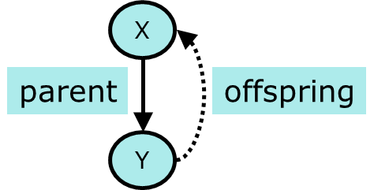
1.2 Defining relations by rules
Rules have:
  A condition part (body)
    the right-hand side of the rule
  A conclusion part (head)
    the left-hand side of the rule
  Example:
    offspring( Y, X) :- parent( X, Y).
    The rule is general in the sense that it is applicable to any objects X and Y.
    A special case of the general rule:
      offspring( liz, tom) :- parent( tom, liz).
    ?- offspring( liz, tom).
    ?- offspring( X, Y).

Slide 13
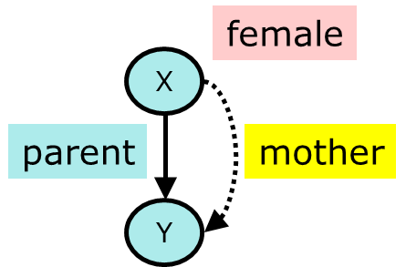
1.2 Defining relations by rules
Define the “mother” relation:
  mother( X, Y) :- parent( X, Y), female( X).
  For all X and Y,
  X is the mother of Y if
  X is a parent of Y and
  X is a female.

Slide 14
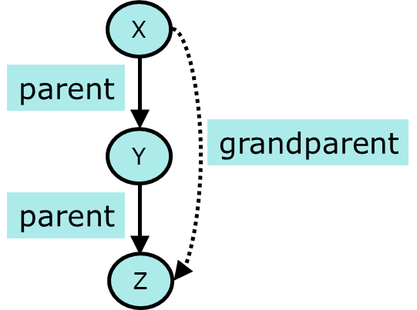
1.2 Defining relations by rules
Define the “grandparent” relation:
  grandparent( X, Z) :-
  parent( X, Y), parent( Y, Z).

Slide 15
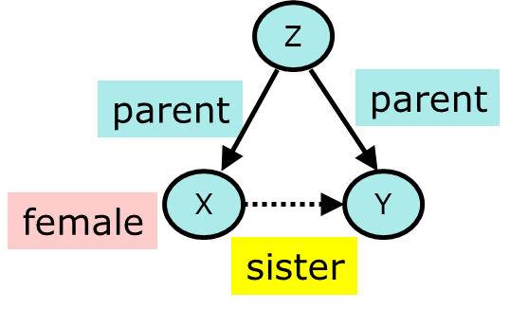
1.2 Defining relations by rules
Define the “sister” relation:
  sister( X, Y) :-
  parent( Z, X), parent( Z, Y), female(X).
  For any X and Y,
  X is a sister of Y if
  (1) both X and Y have the same parent, and
  (2) X is female.
  ?- sister( ann, pat).
  ?- sister( X, pat).
  ?- sister( pat, pat).
    Pat is a sister to herself?!

Slide 16
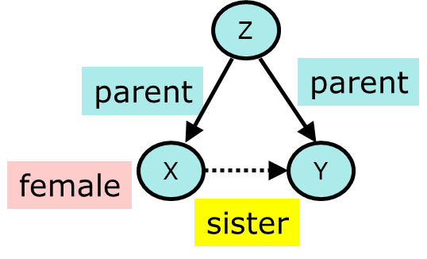
1.2 Defining relations by rules
To correct the “sister” relation:
  sister( X, Y) :-
  parent( Z, X), parent( Z, Y), female(X),
  different( X, Y).
  different (X, Y) is satisfied if and only if X and Y are not equal. (Please try to define this function)

Slide 17
1.2 Defining relations by rules
Prolog clauses consist of
  Head
  Body: a list of goal separated by commas (,)
Prolog clauses are of three types:
  Facts:
    declare things that are always true
    facts are clauses that have a head and the empty body
  Rules:
    declare things that are true depending on a given condition
    rules have the head and the (non-empty) body
  Questions:
    the user can ask the program what things are true
    questions only have the body

Slide 18
1.2 Defining relations by rules
A variable can be substituted by another object.
Variables are assumed to be universally quantified and are read as “for all”.
  For example:
    hasachild( X) :- parent( X, Y).
    can be read in two way
    (a) For all X and Y,
    if X is a parent of Y then X has a child.
    (b) For all X,
    X has a child if there is some Y such that X is a parent of Y.

Slide 19
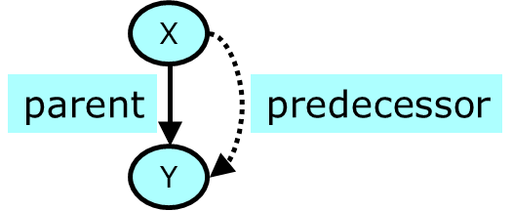
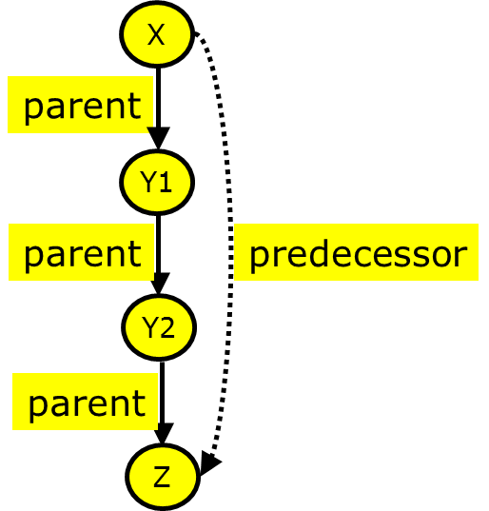
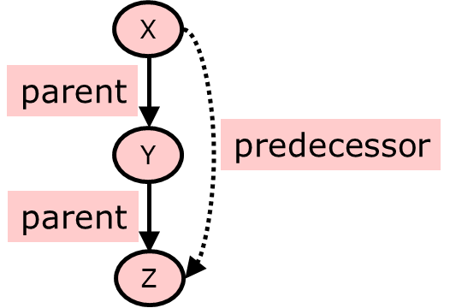
1.3 Recursive rules
Define the “predecessor(祖先)” relation

Slide 20
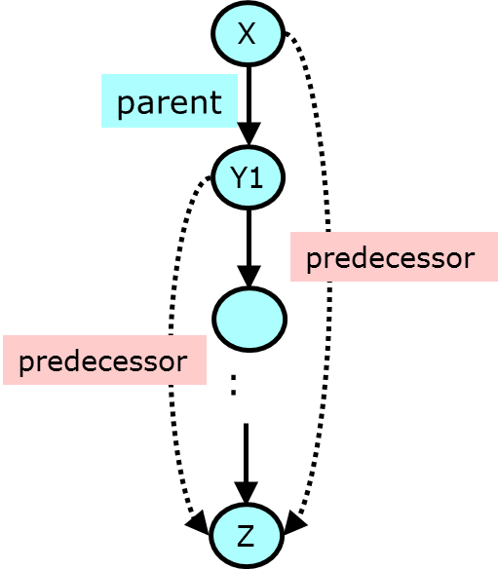
1.3 Recursive rules
Define the “predecessor” relation
  predecessor( X, Z):- parent( X, Z).
  predecessor( X, Z):-
  parent( X, Y), predecessor( Y, Z).
  For all X and Z,
  X is a predecessor of Z if
  there is a Y such that
  (1) X is a parent of Y and
  (2) Y is a predecessor of Z.
  ?- predecessor( pam, X).

Slide 21
1.3 Recursive rules
% Figure 1.8 The family program.
parent( pam, bob).
parent( tom, bob).
parent( tom, liz).
parent( bob, ann).
parent( bob, pat).
parent( pat, jim).
female( pam).
female( liz).
female( ann).
female( pat).
male( tom).
male( bob).
male( jim).
offspring( Y, X) :-
parent( X, Y).
mother( X, Y) :-
parent( X, Y),
female( X).
grandparent( X, Z) :-
parent( X, Y),
parent( Y, Z).
sister( X, Y) :-
parent( Z, X),
parent( Z, Y),
female( X),
X \= Y.
predecessor( X, Z) :- % Rule pr1
parent( X, Z).
predecessor( X, Z) :- % Rule pr2
parent( X, Y),
predecessor( Y, Z).

Slide 22
1.3 Recursive rules
Procedure:
  In figure 1.8, there are two “predecessor relation” clauses.
    predecessor( X, Z) :- parent( X, Z).
    predecessor( X, Z) :- parent( X, Y), predecessor( Y, Z).
  Such a set of clauses is called a procedure.
Comments:
  /* This is a comment */
  % This is also a comment

Slide 23
Trace and Notrace
| ?- trace.
The debugger will first creep -- showing everything (trace)
(15 ms) yes
{trace}
| ?- predecessor( X, Z).
1 1 Call: predecessor(_16,_17) ?
2 2 Call: parent(_16,_17) ?
2 2 Exit: parent(pam,bob) ?
1 1 Exit: predecessor(pam,bob) ?
X = pam
Z = bob ? ;
1 1 Redo: predecessor(pam,bob) ?
2 2 Redo: parent(pam,bob) ?
2 2 Exit: parent(tom,bob) ?
1 1 Exit: predecessor(tom,bob) ?
X = tom
Z = bob ? ;
…
X = bob
Z = jim
1 1 Redo: predecessor(bob,jim) ?
3 2 Redo: predecessor(pat,jim) ?
4 3 Call: parent(pat,_144) ?
4 3 Exit: parent(pat,jim) ?
…
4 3 Fail: parent(jim,_17) ?
4 3 Call: parent(jim,_144) ?
4 3 Fail: parent(jim,_132) ?
3 2 Fail: predecessor(jim,_17) ?
1 1 Fail: predecessor(_16,_17) ?
(266 ms) no
{trace}
| ?- notrace.
The debugger is switched off
yes

Slide 24
1.4 How Prolog answers questions
To answer a question, Prolog tries to satisfy all the goals.
To satisfy a goal means to demonstrate that the goal is true, assuming that the relations in the program is true.
Prolog accepts facts and rules as a set of axioms(公理), and the user’s question as a conjectured (推測的) theorem(定理).
Example:
  Axioms: All men are fallible (會犯錯的).
  Socrates is a man.
  Theorem: Socrates is fallible.
  For all X, if X is a man then X is fallible.
  fallible( X) :- man( X).
  man( socrates).
    ?- fallible( socrates).

Slide 25
1.4 How Prolog answers questions
  predecessor( X, Z) :- parent( X, Z). % Rule pr1
  predecessor( X, Z) :- parent( X, Y), % Rule pr2
  predecessor( Y, Z).
?- predecessor( tom, pat).
  How does the Prolog system actually
  find a proof sequence?
    Prolog first tries that clause which appears first in the program. (rule pr1)
    Now, X= tom, Z = pat.
    The goal predecessor( tom, pat) is then replace by parent( tom, pat).
    There is no clause in the program whose head matches the goal parent( tom, pat).
    Prolog backtracks to the original goal in order to try an alternative way (rule pr2).
parent( pam, bob).
parent( tom, bob).
parent( tom, liz).
parent( bob, ann).
parent( bob, pat).
parent( pat, jim).
pam
tom
bob
liz
ann
pat
jim

Slide 26
1.4 How Prolog answers questions
  predecessor( X, Z) :- parent( X, Z). % Rule pr1
  predecessor( X, Z) :- parent( X, Y), % Rule pr2
  predecessor( Y, Z).
?- predecessor( tom, pat).
    Apply rule pr2, X = tom, Z = pat,
    but Y is not instantiated yet.
    The top goal predecessor( tom, pat) is replaces by two goals:
      parent( tom, Y)
      predecessor( Y, pat)
    The first goal matches one of the facts. (Y = bob)
    The remaining goal has become
    predecessor( bob, pat)
    Using rule pr1, this goal can be satisfied.
      predecessor( bob, pat) :- parent( bob, pat)
parent( pam, bob).
parent( tom, bob).
parent( tom, liz).
parent( bob, ann).
parent( bob, pat).
parent( pat, jim).
pam
tom
bob
liz
ann
pat
jim

Slide 27
1.4 How Prolog answers questions
predecessor( tom, pat)
By rule pr1
By rule pr2
parent( tom, pat)
parent( tom, Y)
predecessor( Y, pat)
no
Y = bob
By fact
parent( tom, bob)
The top goal is satisfied when a path is found from the root node to a leaf node labeled ‘yes’.
The execution of Prolog is the searching for such path.
predecessor( bob, pat)
By rule pr1
parent( pam, bob).
parent( tom, bob).
parent( tom, liz).
parent( bob, ann).
parent( bob, pat).
parent( pat, jim).
parent( bob, pat)
yes
  predecessor( X, Z) :- parent( X, Z). % Rule pr1
  predecessor( X, Z) :- parent( X, Y), % Rule pr2
  predecessor( Y, Z).
derivation diagrams

Slide 28
Trace
  predecessor( X, Z) :- parent( X, Z). % Rule pr1
  predecessor( X, Z) :- parent( X, Y), % Rule pr2
  predecessor( Y, Z).
predecessor( tom, pat)
parent( pam, bob).
parent( tom, bob).
parent( tom, liz).
parent( bob, ann).
parent( bob, pat).
parent( pat, jim).
By rule pr1
By rule pr2
parent( tom, pat)
parent( tom, Y)
predecessor( Y, pat)
no
Y = bob
By fact
parent( tom, bob)
| ?- predecessor( tom, pat).
1 1 Call: predecessor(tom,pat) ?
2 2 Call: parent(tom,pat) ?
2 2 Fail: parent(tom,pat) ?
2 2 Call: parent(tom,_79) ?
2 2 Exit: parent(tom,bob) ?
3 2 Call: predecessor(bob,pat) ?
4 3 Call: parent(bob,pat) ?
4 3 Exit: parent(bob,pat) ?
3 2 Exit: predecessor(bob,pat) ?
1 1 Exit: predecessor(tom,pat) ?
true ?
predecessor( bob, pat)
By rule pr1
parent( bob, pat)
yes
derivation diagrams

Slide 29
1.5 Declarative and procedural meaning of programs
Two levels of meaning of Prolog programs:
  The declarative (宣告的) meaning
    concerned only with the relations defined by the program
    determines what will be the output of the program
    The programmer should concentrate mainly on the declarative meaning and avoid being distracted by the executional details.
  The procedural (程序的) meaning
    determines how this output is obtained
    determines how the relations are actually evaluated by the Prolog system
    The procedural aspects cannot be completely ignored by the programmer for practical reasons of executional efficiency.

